Slide 1
ADHD Medication Update
Barbara J Howard, MD
bhoward@chadis.com
www.CHADIS.com

Slide 2
I & my spouse have the following financial relationship with the manufacturer of any commercial product and/or provider of commercial services discussed in this CME activity: CHADIS
The Center for Promotion of Child Development through Primary Care and its for-profit subsidiary, Total Child Health, Inc. developed CHADIS, a web-based screening and decision support system. Dr. Howard is President and she and her spouse Dr. Sturner are members of the Board of Directors of the for-profit subsidiary, Total Child Health. Dr. Sturner is Director of the Center and both are members of its Board of Directors. They are paid consultants to both entities. The terms of the arrangement are being managed by The Johns Hopkins University in accordance with its conflict of interest policies.
I do not intend to discuss an unapproved/investigational use of a commercial product/device in my presentation.

Slide 3
Problems with PCP Management
Children managed by community physicians do significantly poorer than optimized treatment (MTA study) initially
Optimal treatment requires ongoing feedback from home and school- rare
Follow up visits are needed- only 53% provide them
Families skeptical of medicine tend to discontinue even when child is correctly diagnosed and doing well
Families may resort to alternative treatments

Slide 4
#3 Recommend stimulant medicine and/or behavior therapy
Stimulants are first line. Behavior therapy may be helpful or an adjunct. Behavior therapy first for preschoolers.
Stimulants improve core symptoms equally. 50% of children respond to one but not to another.
Stimulants require no serologic, hematologic, or EKG monitoring.
3A: If one stimulant does not work at the highest feasible dose, try another.
3B: Find highest dose with no side effects or dose at which side effects are tolerable.
3C: If stimulants do not work/not tolerated, try non-stimulants with evidence-basis

Slide 5
Multisite Multimodal Treatment Study (MTA)
600 children (age 7 – 9)
ADHD combined type
24 month outcomes
Groups
Medical management: monthly tailored
Behavioral Therapy: 8 week summer; training; in-class aid, teacher consultation
Combined
Community standard: 67% meds mostly bid

Slide 6
MTA Results
Medical management or combination therapy had better outcomes than behavioral therapy or community care
Combined therapy was equal to medical for ADHD sx but for subgroups combined may be preferable
Anxiety disorders; high levels of socio-economic and/or family stressors
8 year f/u: groups were equal (but no control group)

Slide 7
Caveats
Many forms, esp since adderall became generic
Many studies where authors were receiving money from pharma companies
Studies usually short- often <12 weeks
New forms may require preauthorization

Slide 8
Medication Choice: Stimulants
MPH and DA are approximately equivalent in efficacy (75%) & side effects
Some children respond better to one
MPH dose = 0.3 - .5 mg/kg/dose; DA = 0.15-0.25mg/kg/dose
Ritalin SR is less effective and slower onset than short acting. Ritalin LA more reliable
Long acting DA is more likely to cause sleep problems
Dexedrine SR- 10-12 hours, greater anorexia, irritability?
Adderall- 4-6 hours, Adderall XR 10-12 smoother
Pemoline (Cylert) is not available because of liver toxicity->death

Slide 9
Medication - Dosing
Short acting lasts 3 1/2 to 4 hours
Children benefiting from school dosing usually can benefit from a 3rd dose
Long acting now recommended
Consider using a placebo trial- shared decisions
With weekly parent and teacher ratings to establish objectivity
Helps parents carefully sort out their fears from fact
Helps establish an optimal dosage early
Adjust q 3-7 days, visits q mo until stable then q 3 months for 1st year then q 6 months

Slide 10
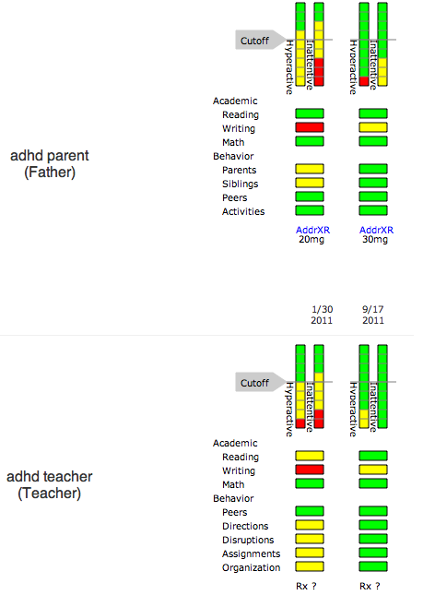
CHADIS Graphic display of Vanderbilt

Slide 11
Other LA stimulants for ADHD
MPH
Concerta
Focalin- d MPH- Short acting; ½ dose; same effectiveness and side effects
Focalin XR (5,10,20)- 10-12 hours, same side effects
Methylin liquid 5 or 10/5cc short acting
Metadate CD- MPH, 6 hours, can sprinkle
Ritalin LA- MPH, 8-10 hours
Daytrana or MTS or MethyPatch
Quillivant and Quillichew
DA
Vyvanse = Slow release mixed salts of amphetamine
Procentra = Liquid Dexedrine 5 mg/5 cc

Slide 12
Methylphenidate Transdermal System or Daytrana or MethyPatch
Takes 2 hours for effect, remove at 9 hours, lasts 12
Signif. effective vs placebo
Potential for sensitization to methylphenidate due to topical route
MTS vs Concerta: Insomnia 13% vs 8%; anorexia 26% vs 19%
12.5 cm = 18 mg Concerta, 18.75 cm = 27 mg Concerta, 25 cm = 36 mg Concerta, 37.5 cm = 54 mg Concerta

Slide 13
Procentra
Dextroamphetamine 5 mg/5 ml
Lasts 4-8 hours; T1/2 11.75 hours. Bubble gum flavor.
3 years +
3-5 years start with 2.5 mg, 6+yrs start 5 mg
Max. 40 mg

Slide 14
Zenzedi (IR)
Dextroamphetamine IR tablet
Dose 2.5, 5, 7.5, 10, 15, 20, 30
Ages 3-16
3-5 yrs give 2.5 and increase; 6yrs+ 5 mg and increase; max 40
Peaks at 3 hours, second dose at 4-6 hours

Slide 15
What’s New? ODT
Oral dissolving tablet
On tongue; do not chew; do not push through foil or touch with wet hands;

Slide 16
Cotempla XR-ODT
Long-acting oral dissolving methylphenidate.
Signif diff from placebo 1-12 hours
8.6 (10 mg MPH ER), 17.3 (20), 25.9 (30) mg
25% IR, 75% ER. Do not chew or crush.Grape.
Ages 6-17
Start at 17.3, increase weekly, max 51.8 mg
Call 844-423-9369 for availability

Slide 17
Adzenys XR -ODT
Orally disintegrating mixed salts amphetamine
5 hours maximum concentration if fasting; 7 hours with food and 19% reduction in maximum concentration.
Age 6+
50% IR, 50% ER
3.1, 6.3, 9.4, 12.5, 15.7, 18.8 mg Orange
Start at 6.3 and increase wkly,
Max 18.8 for 6-12 yr olds; 12.5 for 13-17
18.8 = 30 mg Adderall XR
Exactly the same pharmacodynamics as Adderall XR
Call 844-423-9369 for availability

Slide 18
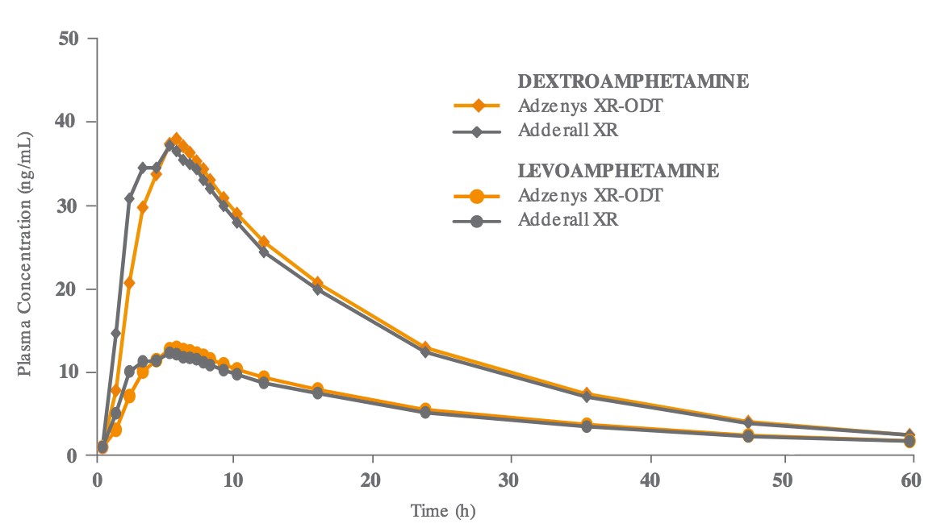
Adzenys XR ODT

Slide 19
New XR medications

Slide 20
Aptensio XR capsules
Methylphenidate extended release
6 years+
IR 40%, controlled release layer 60%
10 mg, 15, 20, 30, 40, 50, 60 mg equivalent to 8.6 mg, 13.0, 17.3, 25.9, 34.6, 43.2, or 51.9 of methylphenidate free base.
Start at 10 mg, increase wkly, max 60. Only 20 & 40 mg better than placebo.
Can sprinkle, do not chew or store. Avoid fat.

Slide 21
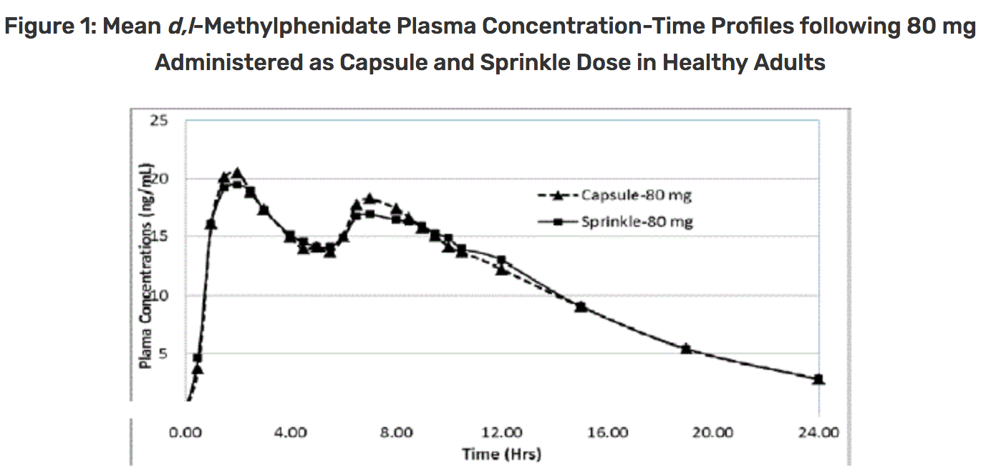
Aptensio

Slide 22
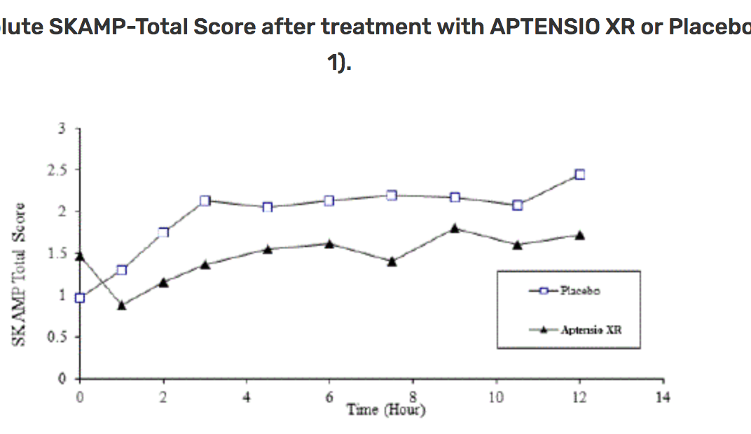
Aptensio vs Placebo

Slide 23
Dyanavel XR
Extended release amphetamine liquid
drug is bound to the ion exchange resin; IR and ER. ER is coated with an aqueous, pH-independent polymer.
2.5 mg/1 cc (equals 4 mg Adderall)
Start 2.5 to 5 mg up to 20 mg
Signif diff from placebo 1-13 hours.
Bubble gum flavor. Shake well.
Best prior to eating.
Food (especially fat) delays onset by one hour
Alcohol causes dumping. Antacids inc. level. Ascorbic acid decreases.

Slide 24
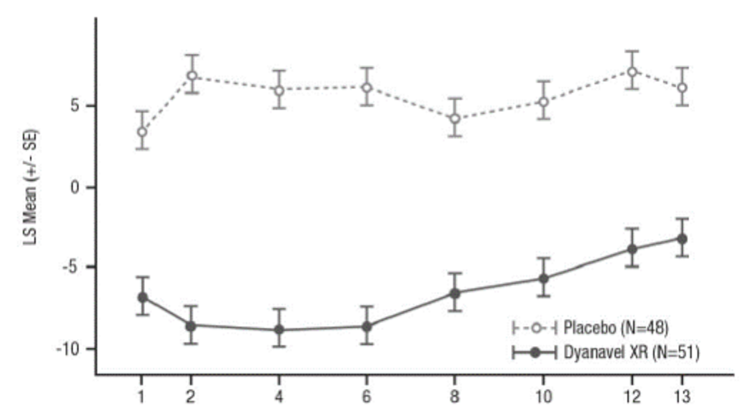
Dyanavel XR vs placebo

Slide 25
Mydayis capsules
Mixed Amphetamine salts (with 3:1 dextro to levo base)
3 different beads releasing at different ph's extending duration to 16 hours (starts 2 – 4 hrs);
Hint- like Adderall XR but 3 types of beads and lasts longer – up to 16 hours
Approved only >12 years so far

Slide 26
Non-stimulants for ADHD
Atomoxetine
Intuniv = guanfacine extended release
Clonicel = long acting clonidine (KapVay)

Slide 27
Atomoxetine (Strattera)
Norepinephrine reuptake inhibitor- not category II
CYP2D6 metabolized, T1/2 5.2 h
Signif better than placebo in child & adult
Side effects: anorexia 14%, N/V/D 12-15%, dizziness, fatigue 9%, mood swings 5% SUICIDAL
Possible inc or dec BP, inc pulse, allergic rash
Recent reports liver abnormalities and failure
Contraindicated near MAO inhibitors
0.5mg/kg->2.0 q 3 d max 100mg div qd-bid. Less with paroxetine or fluoxetine
Takes 4-6 or even 9 weeks to max effectiveness

Slide 28
Intuniv FDA approved 6/07
Selective agonist for alpha-2A-receptors in the prefrontal cortex
Nonstimulant
Monotherapy or adjunct
Once daily long acting; am or pm
Ages 6 to 17 years
1 mg to 4 mg daily
Better than placebo in 2 double blind trials
Main side effect is sedation, hypotension
Takes 2-4 weeks for effect; taper to stop

Slide 29
Other Nonstimulants
Clonidine: 4-5 microgram/kg/day or Guanfacine (Tenex) long acting (Kapvay); esp for aggression and when sedation HS needed; cvs concerns
Bupropion

Slide 30
Bupropion (Wellbutrin)
Antidepressant with stimulant action (beta noradrenergic receptors and prefrontal lobe)
Significant effect on ADHD but less effect size than first line stimulants
Better than nicotine patch for smoking cessation ("Zyban")
Dosage: 3-6 mg/kg (</=300/day); 75, 100, &
150 mg SR
5. Side-effects (especially if increase fast): Decreased seizure threshold (rate = .06%), agitation, insomnia

Slide 31
Vayarin (Omega -3)
Eicosapentaenoic acid (EPA) 21.5 mg Docosahexaenoic acid (DHA) 8.5 mg Phosphatidylserine (PS) 75 mg
60% taking 3 months noticed some benefit.
Only 40% stayed with it (Nguyen et al., 2014).
$60/mo no insurance coverage
200 randomized double-blind, placebo-controlled trial 15 weeks on 300 mg PS, 86 mg EPA and 34 mg DHA had significant reduction Connors parent assessment.

Slide 32
Stimulant Side Effects
Common: anorexia, headache, stomach aches, skin picking, tics. Fatigue and depression if stop higher dose.
Uncommon:
Psychosis
Glaucoma, blurred vision
Priapism
Raynaud’s syndrome
Seizures
Abuse
Serotonin Syndrome in combination c other meds

Slide 33
Serotonin Syndrome
Amphetamines + other substance
Symptoms include agitation, hallucinations, coma or other changes in mental status, problems controlling your movements or muscle twitching, fast heartbeat, high or low blood pressure, sweating or fever, nausea or vomiting, diarrhea, and muscle stiffness or tightness.
Occurs with MAOIs, SSRIs, SNRIs, triptans, tricyclics, fentanyl, lithium, tramadol, tryptophan, buspirone, and St. John’s Wort

Slide 34
Stimulants and CV Risk
FDA reports showed:
25 patients (19 who were 18 years and younger) taking stimulants had suddenly died.
54 more patients on these pills had unusual heartbeats, heart attacks, or strokes. Some had preexisting heart problems, some were taking other pills, including cocaine.
AAP advises continuing current practice
FDA- no black box warning
Prudent to avoid use in structural heart disease, arrythmia, ? if FH sudden cardiac death

Slide 35
Managing Side Effects
Appetite - “4th meal” at bedtime
Abdominal pain – disappears in 3 wks; try slow acting medication; ?bowel urgency; give with food
Headache – disappears in 3 wks; try slow acting, use 7 days/wk
Growth – 1 kg, 1-2 cm; mostly nutrition related; reversible with drug holidays if needed
Tics - mostly due to comorbidity, may have less tics with stimulants; 0.5% chance of a persistent problem; try lower dose
Irritability- change family of meds, use another dose in pm

Slide 36
Sleep problems in ADHD
85% of children with ADHD have sleep problems before using meds
Sleep debt makes ADHD and comorbid conditions worse
Mostly trouble falling asleep but also restless
Consider OSA if snore, bipolar if up for hours in the middle of the night
Start with routine bedtime, back rub, milk, white noise
Meds prn: evening stimulant dose, melatonin 1-8 mg, Clonidine 0.05-0.1 mg., guanfacine up to 1 mg

Slide 37
For CME
2 things you will do differently or think differently about as a result of this webinar
Send to bhoward@chadis.com

Slide 38
Selected References
AACAP, Practice Parameter for the Assessment and Treatment of Children and Adolescents With Attention-Deficit/Hyperactivity Disorder. J. Am. Acad. Child Adolesc. Psychiatry, 2007;46(7):894-921.
October 16, 2011, doi: 10.1542/peds.2011-2654

Slide 39
Appendix to ADHD Clinical Practice Guideline: Implementing the Key Action Statements — An Algorithm and Explanation for Process of Care for the Evaluation, Diagnosis, Treatment and Monitoring of ADHD in Children and Adolescents (http:/​/​pediatrics.aappublications.org/​content/​suppl/​2011/​10/​11/​peds.2011-2654.DC1/​zpe611117822p.pdf)

Slide 40
AAP, Caring for Children with ADHD: A Resource Toolkit for Clinicians, 2nd Edit. 2011. Item #: CD0063 ISBN 13: 978-1-58110-578-0
AAP, 2011. ADHD: Clinical Practice Guideline for the Diagnosis, Evaluation, and Treatment of Attention-Deficit/Hyperactivity Disorder in Children and Adolescents. Pediatrics Vol. 128 No. 5 November 1, 2011 pp. 1007 -1022

Slide 41
AAP, 2001. Clinical Practice Guideline: Treatment of the School-Aged Child With Attention-Deficit/Hyperactivity Disorder. Pediatrics 108 (4) 1033

Slide 42
American Academy of Pediatrics, Committee on Quality Improvement and Subcommittee on Attention-Deficit/Hyperactivity Disorder. 2000. Diagnosis and evaluation of the child with attention-deficit/hyperactivity disorder. Pediatrics. 105:1158–1170

Slide 43
Atkinson M, Hollis C. 2010. NICE guideline: attention deficit hyperactivity disorder. Arch Dis Child Educ Pract Ed 2010;95:24–27
Epstein JN, Langberg JM, Lichtenstein PK, Altaye M, Brinkman WB, House K, Stark LJ. 2010. Attention-Deficit/Hyperactivity Disorder Outcomes for Children Treated in Community-Based Pediatric Settings. Arch Pediatr Adolesc Med. 2010;164(2):160-165

Slide 44
Wolraich ML, Bard DE, Stein MT, Rushton JL, O’Connor KG, 2010. Pediatricians’ Attitudes and Practices on ADHD Before and After the Development of ADHD Pediatric Practice Guidelines. J. of Att. Dis. 2010; 13(6) 563-572

Slide 45
References:
Barkley, R. A. Attention Deficit Hyperactivity Disorder: A handbook for diagnosis and treatment. New York: Guilford Press, 72 Spring St., New York, NY, 1990.
Culbert TP, Banez, GA, Reiff, MI. Children who have Attentional Disorders: Interventions. Pediatrics in Review 15 (1), 5-14. 1994
Diller, L. H., Running on Ritalin, Bantam Books, New York, NY, 1998.

Slide 46
Gorski P (Ed) 2002, Supplement, The Diagnosis and Treatment of ADHD in Early Childhood: Evidence –Based Controversies and Implications of Practice and Policy, J Dev Beh Ped 23(1S)

Slide 47
Greenhill, L. L., Attention-Deficit Hyperactivity Disorder: The Stimulants. In Riddle, MA, (Ed), Pediatric Psychopharmacology I Child and Adolescent Psychiatric Clinics of North America, January. 123. 4:1, Saunders, Phila, PA. 1995
Papolos D and Papolos J: The Bipolar Child. Broadway Books, NY, 1999

Slide 48
Reiff MI, Banez, GA, Culbert TP. Children Who Have Attentional Disorders: Diagnosis and Evaluation. Pediatrics in Review. 14. 455-469. 1993.
Sturner RA, 2005, Attention Deficit Disorder, In The Child Health and Development Interactive System, www.CHADIS.com

Slide 49
Wolraich, M (Edit.), 1996, The Classification of Child and Adolescent Mental Diagnoses in Primary care. Diagnostic and Statistical Manual for Primary Care (DSM-PC), Child and Adolescent Version, American Academy of Pediatrics
www.nichq.org for Vanderbilt checklist

Slide 50
Omega-3
Bloch, M., & Qawasmi, A. (2011). Omega-3 fatty acid supplementation for the treatment of children with attention-deficit/hyperactivity disorder symptomatology: Systematic review and meta-analysis. Journal of the American Academy of Child and Adolescent Psychiatry, 50, 991-1000.
Manor, I., et al. (2012). The effect of phosphatidylserine containing omega3 fatty-acids on attention-deficit hyperactivity disorder symptoms in children: A double-blind placebo-controlled trial, followed by an open-label extension. European Psychiatry, 27, 335-342.

Slide 51
Manor, I., et al. (2013). Safety of phosphatidylserine containing omega3 fatty acids in ADHD children: A double-blind placebo-controlled trial followed by an open-label extension. European Psychiatry, 28, 386-391.
Nguyen, S., et al. (2014). Efficacy of EPA Enriched Phosphatidylserine-Omega-3 (Vayarin) on Children with ADHD [Abstract]. Neurology, 82, S P7.336.

